Slide 1


Case Study and Its Application

Slide 2

Group Members
Syeda Tahreem Tariq (AI-008)
Maryam Kamal
(AI-007)
Alishba Jawaid
(AI-005)

Slide 3

Introduction to Case Studies
1
In-depth Analysis
Case studies provide a comprehensive look at a specific situation or problem.
2
Real-World Examples
They showcase how organizations have addressed challenges and achieved success.
3
Actionable Insights
The findings can be applied to similar scenarios in different contexts.

Slide 4


What is a Case Study?
Detailed Investigation
Multifaceted Approach
A case study is an in-depth examination of a specific situation or problem faced by an organization.
It involves gathering data from various sources, analyzing the problem, and proposing solutions.
Practical Applications
Case studies help organizations learn from real-world experiences and apply the insights to their own contexts.

Slide 5






Benefits of Case Studies
Problem-Solving
Informed Decisions
Identifies effective strategies for addressing complex challenges.
Provides data-driven insights to support decision-making.
Best Practices
Innovation
Uncovers proven methods and approaches for achieving success.
Inspires new ideas and solutions to drive organizational growth.

Slide 6

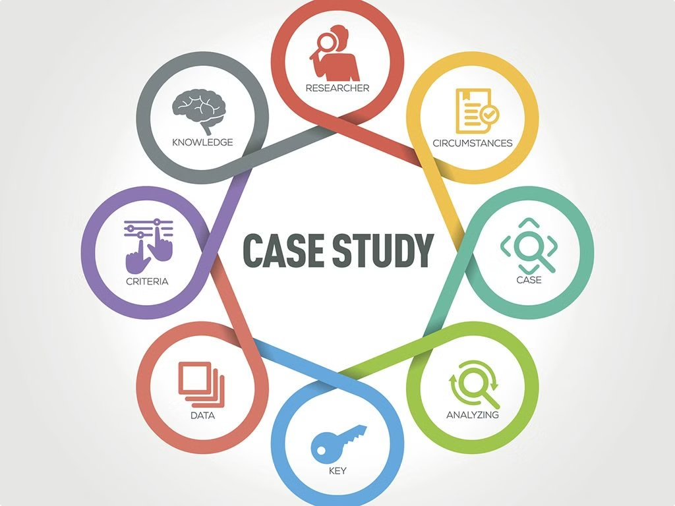
Key Components of a Case Study
1
Background
Provides context and sets the stage for the case.
2
Challenges
Identifies the specific problems or obstacles faced by the organization.
3
Strategies
Explores the approaches and solutions implemented to address the challenges.

Slide 7





Applying Case Study Insights
Analyze
Adapt
Implement
Carefully examine the case study findings and identify the key takeaways.
Consider how the insights can be tailored to fit your organization's unique needs.
Develop a plan to put the case study lessons into action within your own context.

Slide 8

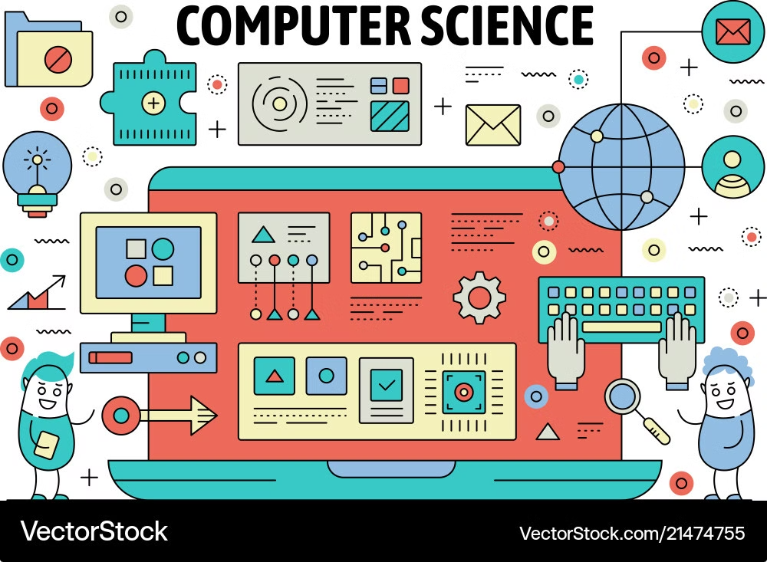
Case Study in Computer Science
Challenge
Improving software development efficiency
Approach
Implementing Agile methodology and DevOps practices
Results
Reduced development time, improved collaboration, and higher customer satisfaction

Slide 9
Case Study Example:
A Violation of Privacy
Marcus is a computer engineer who has recently developed an app which helps users keep track of medical information, doctor’s appointments, and prescriptions.
Information about the user is stored in this app, including what prescriptions they are taking and how frequently they schedule doctor’s appointments. As the developers of the app, Marcus and his company have access to this information.
The marketing department requests Marcus supply them with customer-specific information so they can better target ads and app suggestions to the users. Marcus understands that he is part of a company, but also feels that the privacy of the app users should be protected. Additionally, Marcus feels that as an engineer, he should be responsible to those who use his technology.
How does Marcus determine how much of the user’s information should be shared with marketing? Is this an ethical use of information or a violation of the user’s privacy?
Main Issue :
Marcus must balance user privacy with marketing needs, determining whether to share information ethically by ensuring consent, minimizing data sharing, and protecting user trust in the app.
Solution:
Marcus should advocate for sharing only anonymized data with marketing, ensure user consent is prioritized, and maintain transparency about data use, fostering trust while meeting business objectives.

Slide 10
Applications of Case Studies
Business Strategy
Process Optimization
Product Development
Develop effective growth plans and identify new market opportunities.
Streamline operations and improve efficiency across the organization.
Design innovative solutions that meet customer needs and preferences.

Slide 11
Conclusion
Case studies are a powerful tool for organizations to learn from real-world examples and apply those insights to drive growth, innovation, and success. By examining specific situations in-depth, businesses can uncover best practices, address challenges, and develop effective strategies for the future.

